Slide 1
Introductory Alexa Workshop
What is Alexa?
What are Alexa skills?
What devices run Alexa skills?
Assumes you have an AWS account

Slide 2
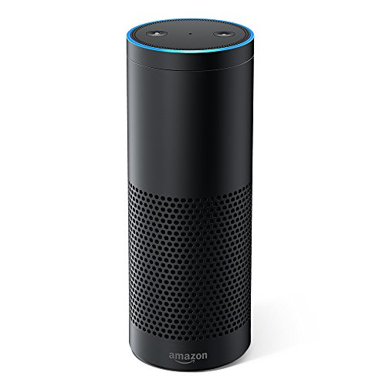
Amazon Echo

Slide 3

Alexa

Slide 4
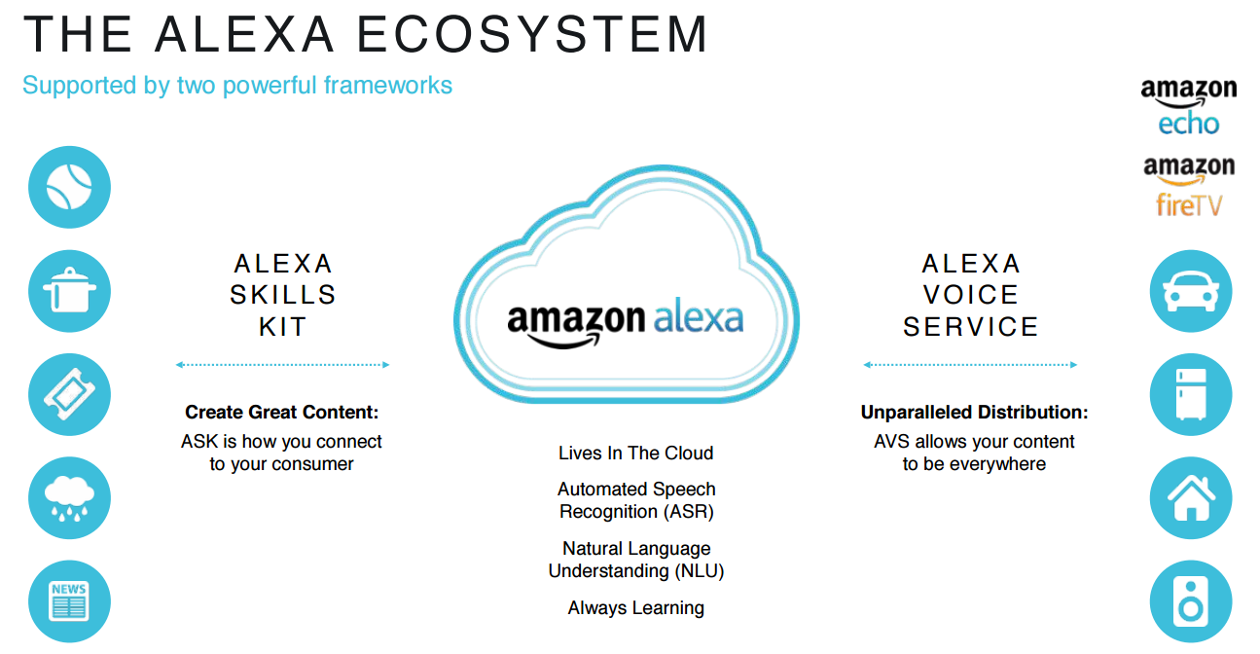

Slide 5
Environment Setup
Create a Cloud9 Environment
Call it “Alexa Workshop”
Use your AWS credentials
AWS Cloud9 -> Preferences -> AWS SETTINGS -> disable AWS managed temporary credentials
From the command line, run “aws configure”

Slide 6
Developer Links
AWS Console
https://aws.amazon.com/
Amazon Developer Portal
https://developer.amazon.com/
Amazon Alexa Account
https://alexa.amazon.com
Alexa Skill Testing Tool
https://echoism.io

Slide 7
Node.js
Verify Node.js is installed:
node –v
npm -v
If not, install Node.js
https://nodejs.org/en/
node -v
npm -v

Slide 8
Alexa Node.js SDK
Install the Alexa SDK for Node.js
npm install --save alexa-sdk
This Alexa Skill Kit SDK for Node.js website:
https://github.com/alexa/alexa-skills-kit-sdk-for-nodejs

Slide 9
Code Files on GitHub
Go to this GitHub account download everything as a zip file:
https://github.com/bklug/introductory-alexa-workshop
Upload the zip file into Cloud9.
Unzip the file.
Delete the zip file.
Open the “00-hello-basic-skill” folder in your editor
Let’s examine the directories and files

Slide 10
Voice Model Components
Intent Schema
Voice “slots” that capture words spoken by the user
Sample Utterances
Phrases used to invoke the intents
Custom Slot Types
User-defined voice slots versus built-in intents
Lambda code
Processes user interaction with the device

Slide 11
Amazon Developer Portal (1)
Log into the developer portal using you AWS credentials:
https://developer.amazon.portal
Create a skill - “blood test results”
Custom skill from scratch & Provision your own
Change the invocation name – “blood results”
Spaces important!
Save Model

Slide 12
Amazon Developer Portal (2)
Add an Intent
Call it “Hello”
Add Sample Utterances from the SampleUtterances.txt file in the speechAssets directory
These words invoke the intent
Add “Hello”
Add “Hi”
Save Model
Build Model

Slide 13
Lambda Code (1)
Index.js
exports.handler parameters
Event – JSON file sent from device to the handlers
Context – runtime information
Callback – optional; returns information to the caller. (We’ll use this later.)

Slide 14
Lambda Code (2)
Handlers
LauchRequest intent
Hello intent
Built-in intents
Add your own responses to these intents

Slide 15
Lambda Function (1)
Log into the AWS Console
Create a Lambda function from scratch
Name – “alexa-blood-test-results”
Runtime – Node.js 8.10
Choose an existing role
lamba_basic_execution

Slide 16
Lambda Function (2)
Add trigger
Alexa Skills Kit
Note available in all regions
Disable “Skill ID verification” (temporary)
Add & Save

Slide 17
Lambda Function (3)
Copy the Lambda function ARN to your skill in the developer portal
On the left, select Endpoint
Service Endpoint Type
AWS Lambda ARN
Paste ARN into the Default Region field
Save Endpoints

Slide 18
Deploy Lambda Code (1)
From your Cloud9 terminal window, navigate into the Lambda directory under “00-hello-basic-skill”
Run “npm init”
This says “install in this directory”
Run “npm install --save alexa-sdk”
Installs the Alexa SDK (node_modules)

Slide 19
Deploy Lambda Code (2)
Open & verify the “publish_lambda.sh” file
Mac or Linux – execute the publish_lambda.sh
“chmod +x publish_lambda.sh”
“./publish_lambda.sh”
Windows
PowerShell “compress-archive” won’t work
From File Explorer, select the files in the lambda directory (not the lambda dir. itself)
Send to -> Compressed (zipped) folder
Save as lambda.zip

Slide 20
Deploy Lambda Code (2)
Open & verify the “publish_lambda.sh” file
Mac or Linux – execute the publish_lambda.sh
“chmod +x publish_lambda.sh”
“./publish_lambda.sh”

Slide 21
Deploy Lambda Code (3)
From your terminal window, navigate to the directory containing the lambda.zip file
Copy and paste the last line in the publish_lambda.sh file
Make sure the --function-name makes the lambda function in the AWS console

Slide 22
Test Your Skill (1)
In the Alexa console, select Build.
Verify the skill builder checklist is green
Select Test on the top menu bar
Enable test for this skill

Slide 23
Test Your Skill (2)
Alexa Simulator
Type “open blood results” or
Click and hold the microphone and speak
“ Alexa, open blood results”
Then, type or speak an utterance
“Hello”
“Hi”

Slide 24
JSON Request and Response
Look at the JSON input and output columns
Copy the JSON Input code
Go to your Lambda function in the AWS console
Click the Test button and paste the code
View the Execution results
Should match JSON output in Alexa console

Slide 25
Request and Response JSON Reference
https://developer.amazon.com/docs/custom-skills/request-and-response-json-reference.html

Slide 26
Your Alexa Account
Log into https://alexa.amazon.com
Notice the output from your skill
Do you have the Alexa app on your cell phone?
Output from your skill will appear there, too

Slide 27
Finish This Skill
Add Lambda code to handle these three built-in intents
StopIntent
CancelIntent
NavigateHomeIntent
Test each built-in intent

Slide 28
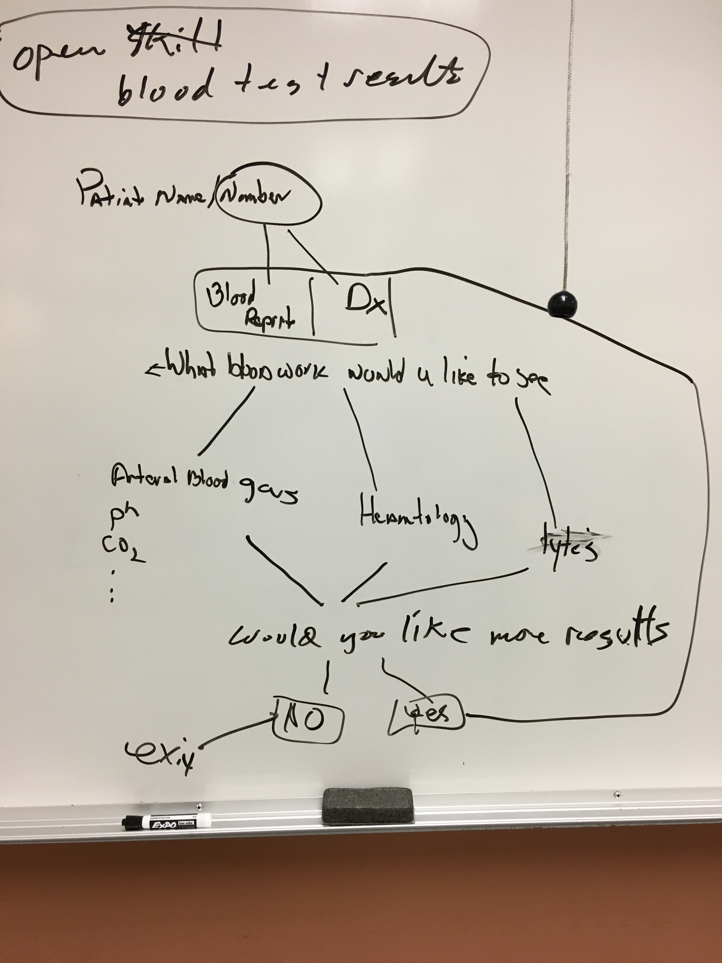
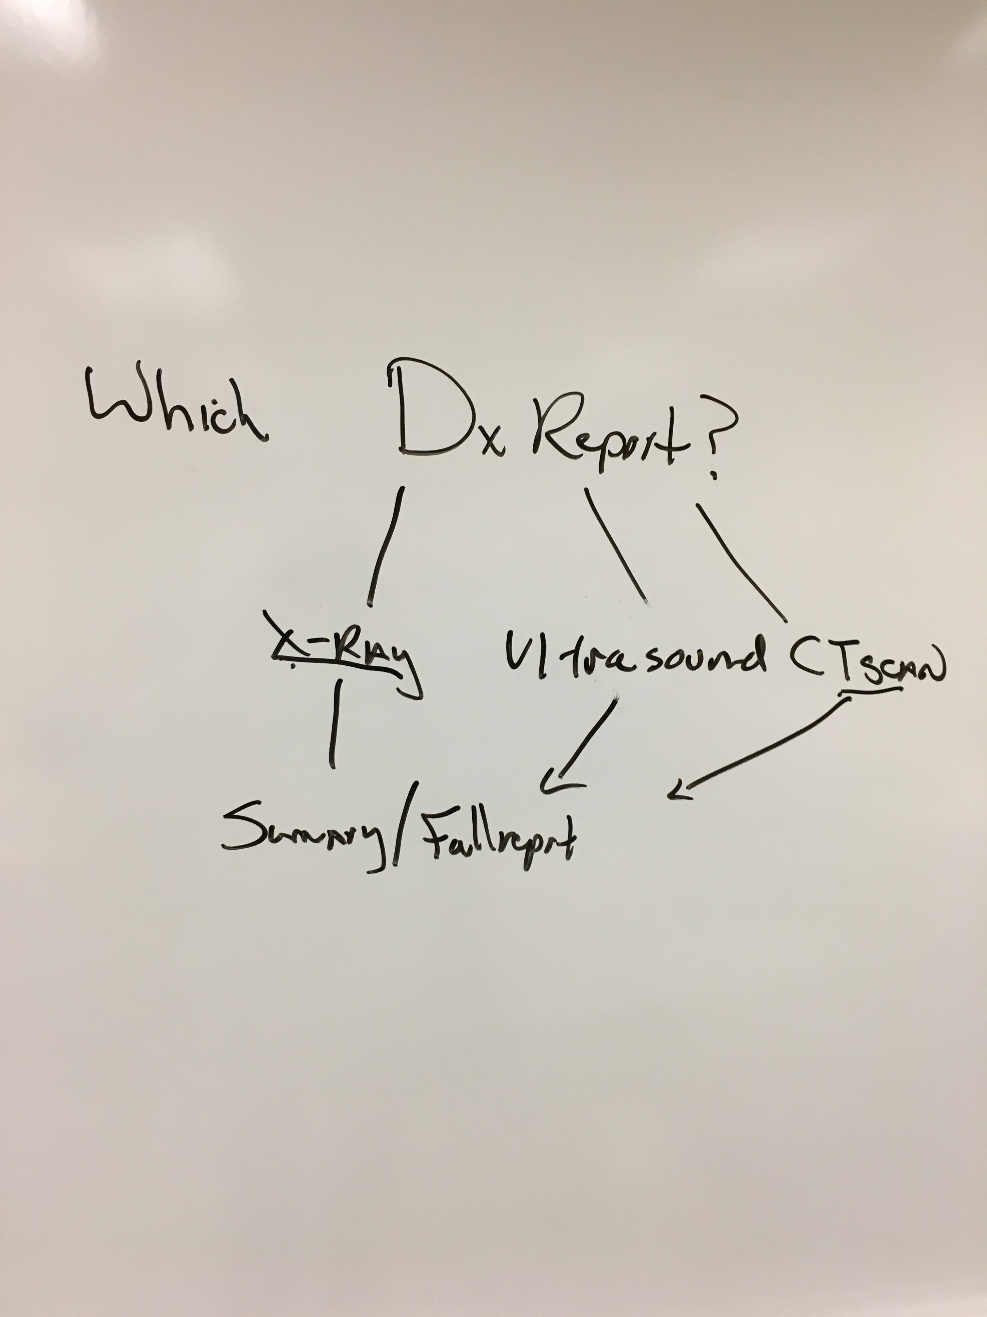
Patient Blood Test Results

Slide 29
Blood Test Results Skill (1)
Custom Slot Types
Gather user data
Slot Type Reference
https://developer.amazon.com/docs/custom-skills/slot-type-reference.html
Session Attributes
Store input data between intents

Slide 30
Blood Test Results Skill (2)
“01-blood-test-results”
Speech Assets
Intent Schema
Sample Utterances
Modify the skill in the developer portal
Remove Hello intent
Add built-in YesIntent
Add built-in NoIntent
Add custom intent for PatientNumber
Add intent slot for patient number (AMAZON.NUMBER)
Add sample utterances
Save and Build your Model!

Slide 31
Blood Test Results Skill Code (1)
Lambda data directory
bloodWork.js
bloodWorkRanges.js
displayBloodResults.js
Index.js
New intents, e.g., Yes & No
Storing patient number -> session attribute

Slide 32
Blood Test Results Skill (3)
From your terminal window, navigate to the Lambda directory under “01-blood-test-results”
Run “npm init”
Run “npm install --save alexa-sdk”
Installs the Alexa SDK (node_modules)

Slide 33
Deploy & Test Lambda Code (1)
Mac or Linux – execute the publish_lambda.sh
“chmod +x publish_lambda.sh”
“./publish_lambda.sh”
Test
In the developer console you must enter “one” not “1”, “two” not “2”

Slide 35
Blood Test Results Skill Code (2)
We use something called a “card”
It will display results here:
Alexa.amazon.com
Your mobile app
Your task -> Add missing built-in intents
When you finish the index.js file, create your ZIP file and upload to AWS
Include the Data directory in the ZIP file
Test!

Slide 36
Blood Test Results – Segmentation (1)
“02-blood-test-segmentation”
Blood Test Results versus Diagnostic Tests
Blood Test Results
Hematology
Arterial Gas
Electrolytes

Slide 37
Blood Test Results – Segmentation (2)
Speech Assets
LanguageModel.json
SampleUtterances.txt
You don’t need to add all of these!
Constants Directory
Constants.js

Slide 38
Blood Test Results – Segmentation (3)
Update the model in the developer portal
First, add custom slot type values for these intents
ReportTypes
BloodReportTypes
Next, add new intents that use new slot types
Add ReportType intent
Add BloodReportType intent

Slide 39
Blood Test Results – Segmentation (4)
Add one utterance to each new intent
ReportType - {Type}
BloodReportType – {BloodType}
Save Model
Build Model

Slide 40
Blood Test Results – Data Decoupling
Store patient data in cloud storage
AWS S3 - Simple Storage Service
Data stored in buckets

Slide 41
AWS S3
Log into the AWS console
Create an S3 bucket
Bucket names must be globally unique!
Upload file from data directory “blood-results.json”
Change IAM role to allow Lambda function to read S3 bucket (or create a new role)
lambda_basic_execution
AmazonS3ReadOnlyAccess

Slide 42
Blood Test Results – S3 Bucket (1)
“03-blood-test-S3-bucket”
Constants.js
Add skill App ID
Specify S3 bucket & file name (key)
New directory Helpers
Function to read S3 bucket
getBloodWorkS3.js

Slide 43
Blood Test Results – S3 Bucket (2)
Index.js
NewSession Intent
Loads patient data from S3 bucket
Stores in session attribute
Calls LaunchIntent

Slide 44
Patient Test Results

Slide 45
Patient Results States
Blood Test Results versus Diagnostic Tests
Blood Test Results
Arterial Blood Gas
Hematology
Electrolytes
Diagnostic Tests
X-Ray
Ultrasound
CT Scan

Slide 46
State Management
Patient identification
Blood test results
Diagnostic reports

Slide 47
Patient Results States (1)
“04-patient-results-states-v1”
Developers portal
Add Diagnostic tests to model
See LanguageModel.json
Major change to index.js
Adding three states

Slide 48
Patient Results States (2)
“04-patient-results-states-v2”
New directory - handlers
Create separate file for each handler
patientIdentificationStateHandlers
bloodTestsStateHandlers
diagnosticReportsStateHandlers

Slide 49
Your Turn
“Quote-of-the-Day” skill
Intents
Greet the user – Hello Intent
Get a quote – Quote Intent
Request another quote – NextQuote Intent
GetQuote function is in GitHub
Use “00-hello-basic-skill” as starting point

